Slide 1

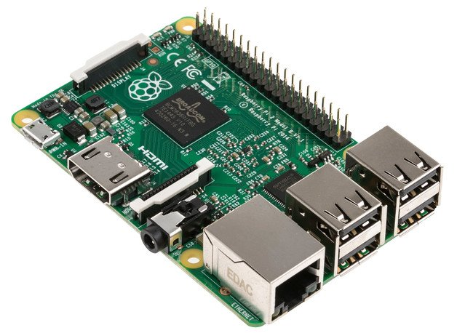

Introduction to Raspberry Pi
Alison Aird

Slide 2
Raspberry Pi versions:
Model B (original, $35) in 2012 - composite video
Model A (smaller, cheaper version) in 2013
Model B+ in 2014 – HDMI video, micro SD
Pi 2 in 2015 – 1Gb RAM, faster processor
Pi 3 in Feb 2016 - built-in wi-fi, bluetooth
Pi Zero W (wireless) in Feb 2017 - smaller, cheaper, low power
Pi 4 in 2019 – Up to 4Gb RAM, 4K video, Dual HDMI

Slide 3
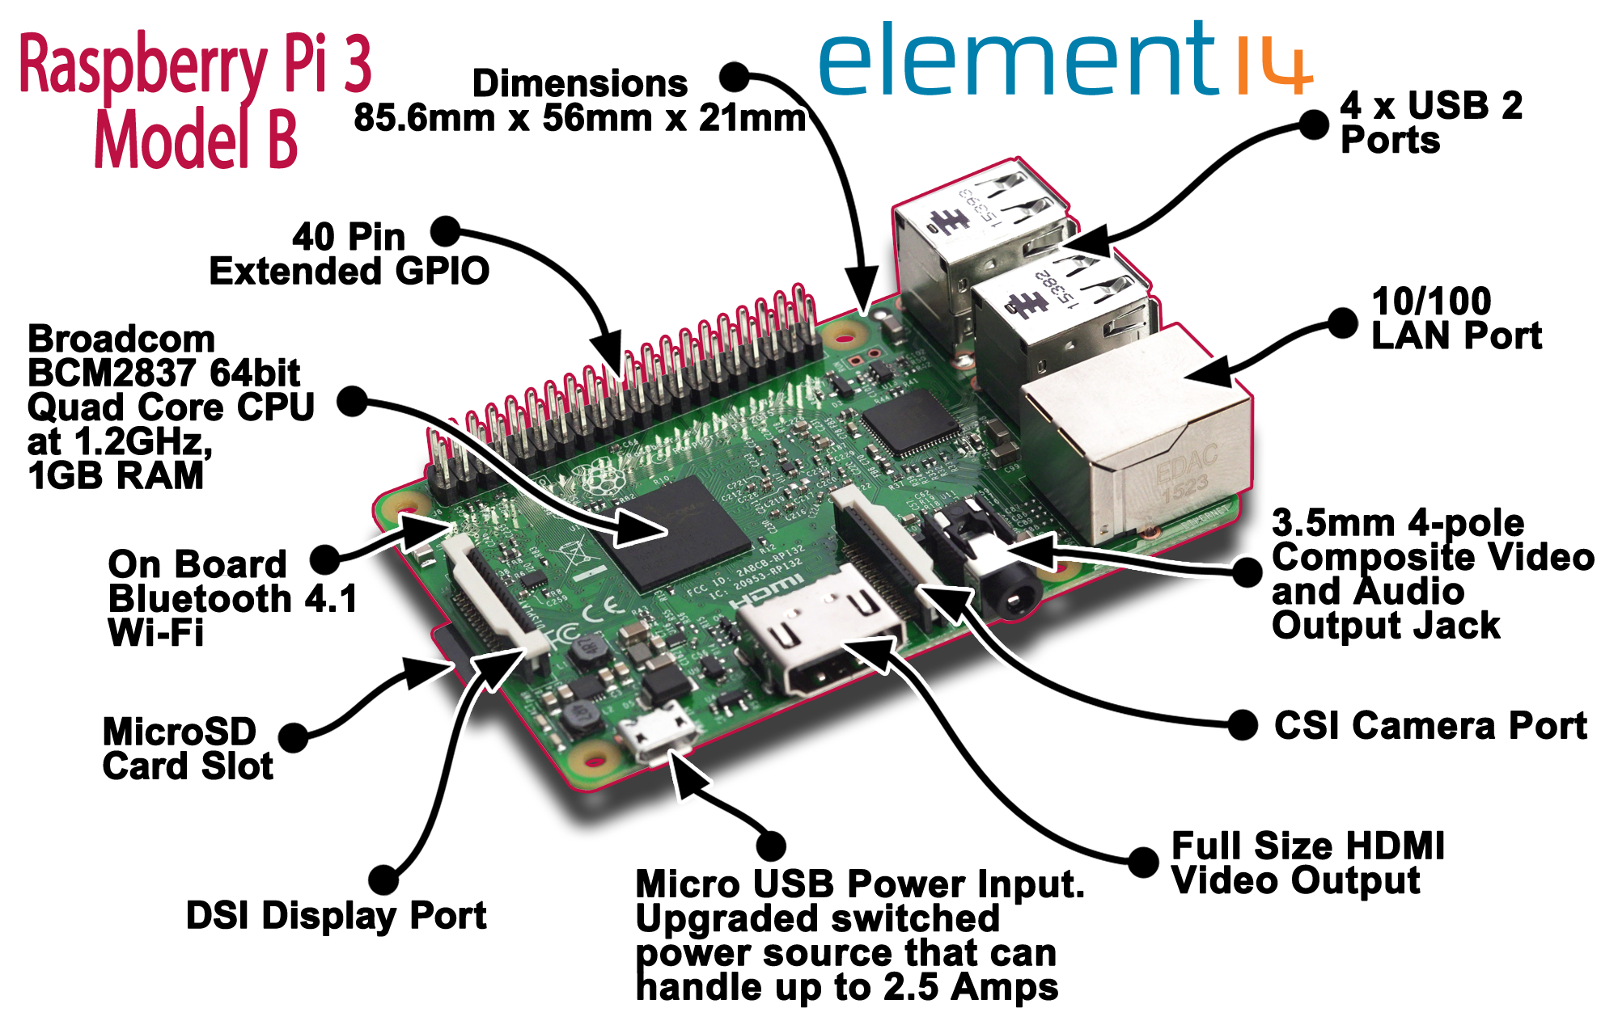

Slide 4
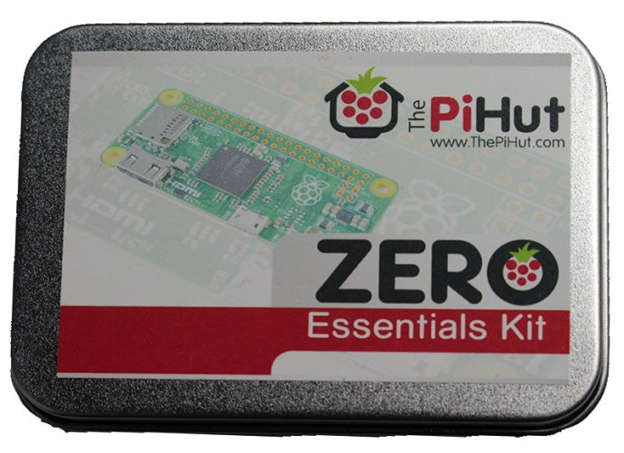
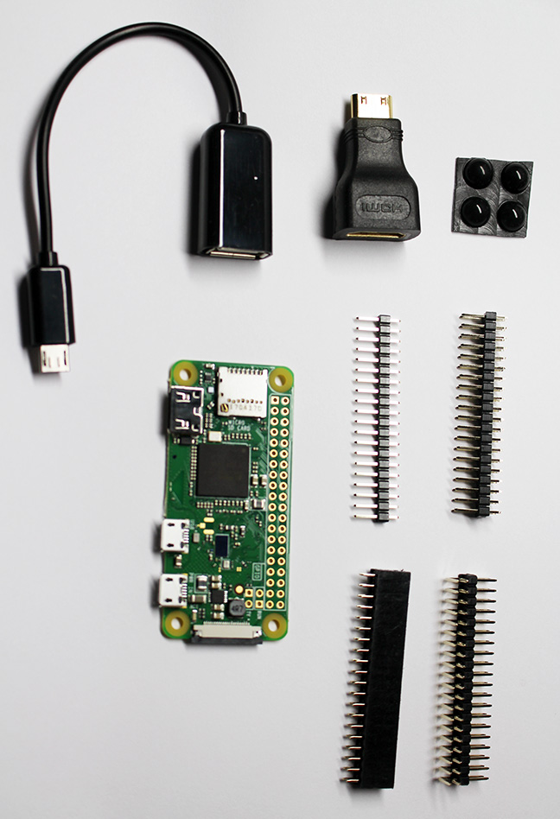
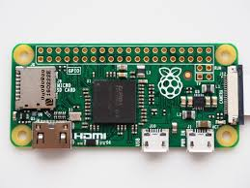
Pi Zero W

Slide 5
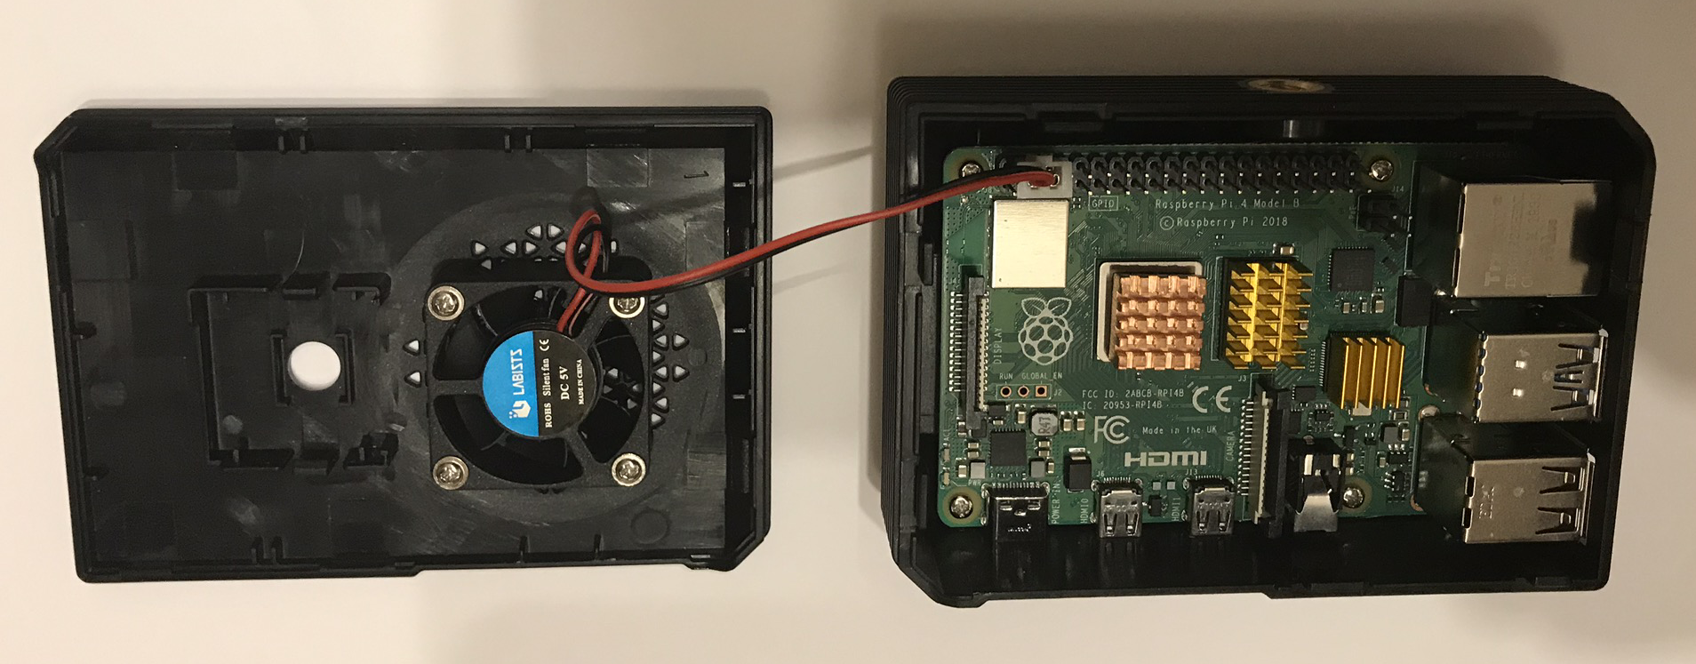
Pi 4
Advantages:
Much faster than older Pi versions
Up to 4Gb RAM, 4K video, dual HDMI display
Disadvantages:
More expensive (around £35 to £55 depending on RAM)
CPU runs very hot – need to install heatsinks and a fan, to keep it around 40oC

Slide 6

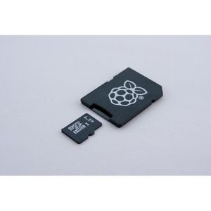
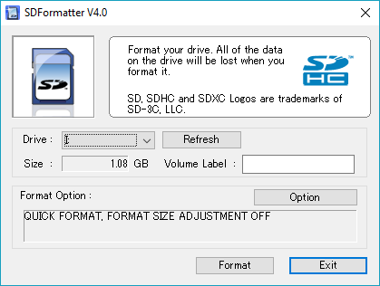
Raspbian (Debian linux version)
Format as FAT32
Windows – need 3rd party tool to format SD
card over 32Gb as FAT32
https://www.sdcard.org/downloads/formatter_4
Download “Noobs” installer (“New Out Of the Box”) and copy to SD card to install Raspbian.
Current version is 3.2.1 (30 Sept 2019)
Use “Noobs Lite” for network install (useful for a smaller SD card, e.g. 8Gb)
https://www.raspberrypi.org/downloads/noobs/
Alternatives to Raspbian:
Ubuntu MATE (Ubuntu desktop)
Windows 10 IOT Core
LibreELEC (Kodi Media Centre)
emteria.OS (Android installation)

Slide 7
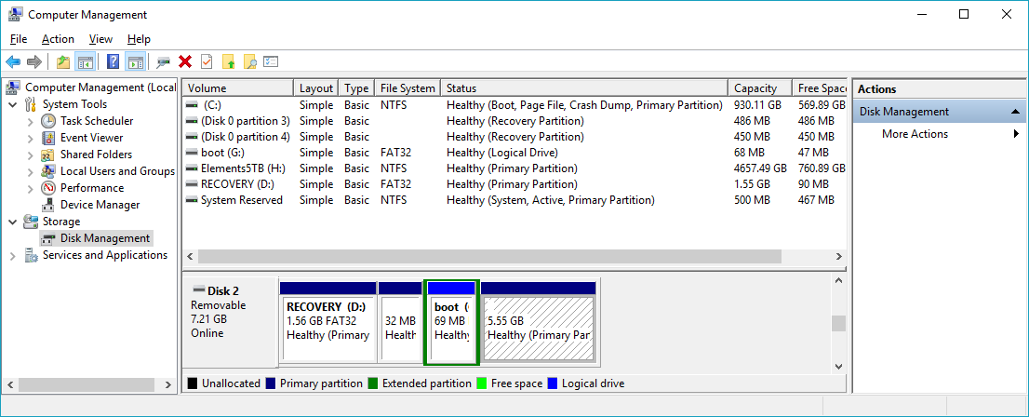
Re-installation to same SD card
SD Card already has been used for Raspbian, but want to refresh to newest version:
Delete multiple partitions from SD card (e.g. with Windows Disk Management tool)
Create new single partition for entire card
Format as FAT32 partition

Slide 8
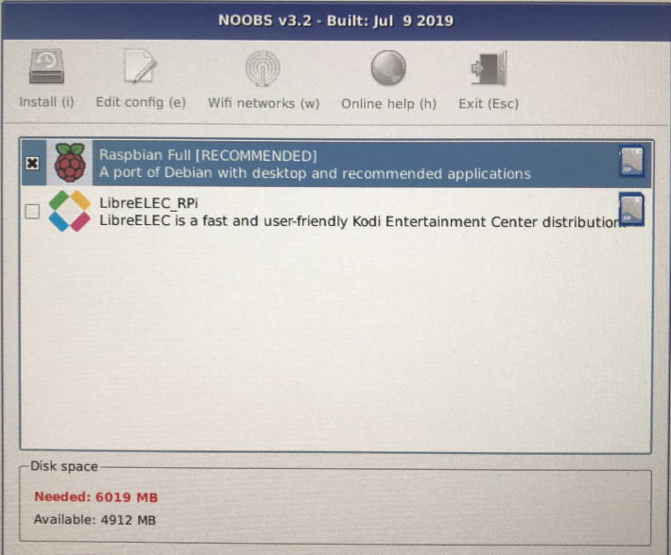
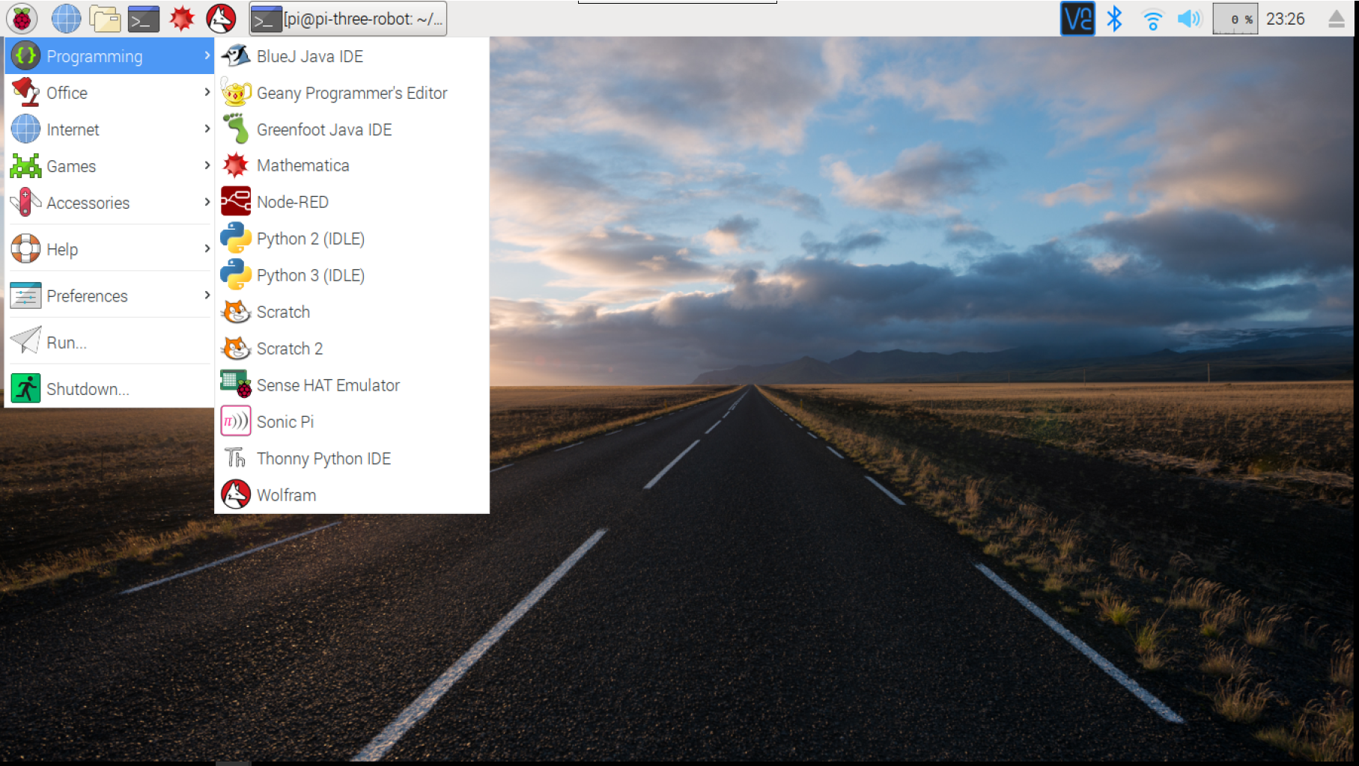
Raspbian Installation

Slide 9
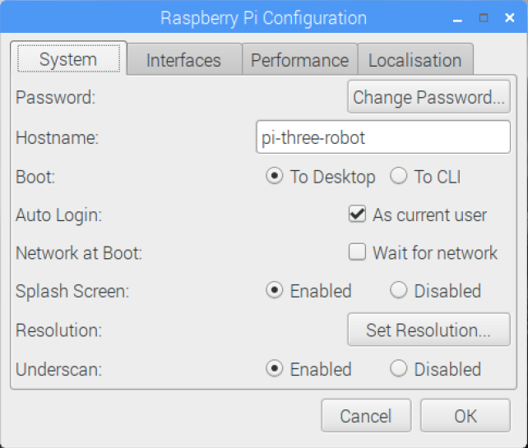
Basic Setup
Default user account:
user: pi password: raspberry
ESSENTIAL: change the default password
Login as pi user
Open a terminal window and type: passwd
Or use “Raspberry Pi Configuration” utility from “Preferences” in the drop-down menu

Slide 10
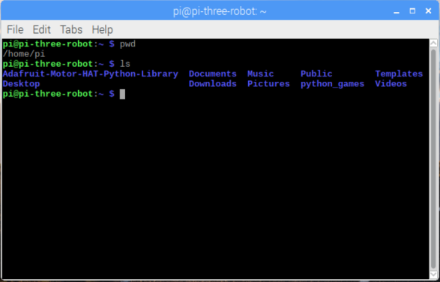
Linux basics
Open a terminal window:
Home directory is /home/pi
sudo = when used before a command, runs it as superuser
ls = list files in the current directory (ls -al gives full details and hidden files)
cd <location> = change directory to <location> (cd .. moves to directory above)
pwd = gives your present working directory
nano newfile.txt = open a new file “newfile.txt” in the “nano” text editor
man <command> = gives the manual entry for the command (e.g. “man ls”)
Beginner’s guide to linux: https://archive.org/details/command_line

Slide 11


Security
Keep system up to date with:
sudo apt-get update
sudo apt-get upgrade
OR re-install Raspbian by clearing SD card with DISKPART (Windows): (This will wipe all files on your Raspberry Pi)
list disk
select disk # (remove sd card and retype list disk if unsure which disk number is the sd card)
clean (WARNING - You MUST have the correct disk number selected in the previous step, or you could accidentally wipe your hard drive)
create partition primary
format fs=fat32 quick
(Use fdisk instead for linux/Mac). Then download newest version of NOOBs and re-install Raspbian on SD Card.
You can change user account name from the default “pi”
sudo adduser newusername
sudo visudo (and edit the “# User privilege specification” section to give your new user sudo access)
logout
Login (as your new user)
sudo deluser pi (to remove the old pi user)
See https://www.raspberrypi.org/documentation/linux/usage/users.md for full details
Use secure, encrypted connections to the Pi, e.g. SSH (secure shell), SFTP (SSH file transfer) - not telnet, FTP
Keep services disabled if not in use (e.g. web server, ftp, mysql)
Keep interfaces disabled if not in use (e.g. SSH, VNC, SPI, Remote GPIO)
Linux firewall - Install and configure iptables
Enable firewall on your home router
Set up logging to monitor logins and failed login attempts
Install virus scanner (e.g. Clam AV)
Debian Linux Security Manual: http://www.debian.org/doc/manuals/securing-debian-howto/

Slide 12
Connecting from your laptop
For Pi 3 or later, enable wi-fi, connect to wi-fi router, and enable VNC (via “Raspberry Pi Configurations” utility).
For older Pi, connect ethernet or add USB wifi dongle and enable wi-fi.
Methods of connection:
Desktop access with VNC Connect from Real VNC Viewer.
Terminal access via SSH (e.g. PuTTY)
File transfer with SFTP (e.g. WinSCP or Filezilla client)

Slide 13
Using VNC Server and Viewer
Enable SSH and VNC in setup menu on Pi, to run VNC server
Download and install VNC Viewer software on your laptop (free for non-commercial use) https://www.realvnc.com/en/connect/download/viewer/
Get IP address of Raspberry Pi (click VNC menu button to see this)
Open VNC Viewer on your laptop, and enter the IP address of the Pi
Screen resolution issues:
Try changing screen resolution from “Raspberry Pi Configurations” utility
If that doesn’t give the required option, modify the settings in //boot/config.txt - can use overscan settings for non-standard resolutions, e.g. 800 x 480 LCD screen

Slide 14

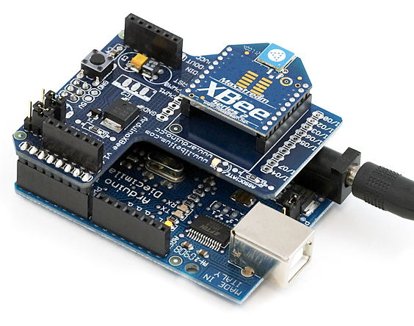
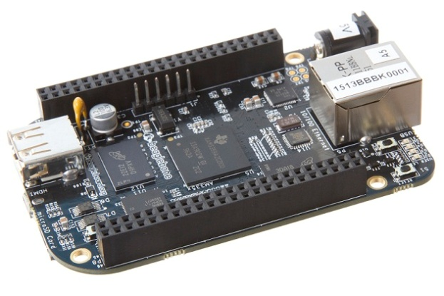
Raspberry Pi alternatives
Pi is a multifunctional computer, with processor threading, file services, etc. Not great for high speed data measurements or highly precise timings. Better to use dedicated hardware or single purpose board (e.g. Arduino).
Not suitable for very low power applications
Pi is fairly low cost, but is overkill (and overpriced) for some simple applications, e.g. LED control on wearables – buy an Arduino nano clone for under £2
Arduino BeagleBoneBlack XBee

Slide 15
Applications (no extra hardware)
Home media server
File storage server
Wireless range extender
Convert your TV to smart TV
Convert old printer to wifi
Configure a web server and run a website
Programming - learn linux, shell scripting, python, Java, Scratch, etc

Slide 16
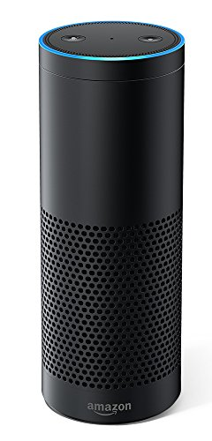
Amazon Alexa Speaker
HARDWARE:
Plug your speaker and USB microphone into your Raspberry Pi
AMAZON SETUP:
Register for an Amazon developer account at https://developer.amazon.com/
Go to the Alexa Voice Service (AVS) Console and click on ‘Products’: https://developer.amazon.com/alexa/console/avs/home
Select ‘new product’ and fill in the details, selecting ‘Device with Alexa built-in’ Will your device use a companion app : no Product category: Other (value: Prototype) Hands Free
Create new security profile, and click on ‘Other devices and platforms’
Enter a client ID name, and click button to generate a client ID.
Click “Download” button and save config.json file.
RASPBERRY PI SETUP:
Copy the config.json file to your home/pi folder
Open a terminal window and enter the following: wget https://raw.githubusercontent.com/alexa/avs-device-sdk/master/tools/Install/setup.sh wget https://raw.githubusercontent.com/alexa/avs-device-sdk/master/tools/Install/genConfig.sh wget https://raw.githubusercontent.com/alexa/avs-device-sdk/master/tools/Install/pi.sh
Run this command in terminal: sudo bash setup.sh config.json and enter AGREE when prompted
Wait for it to finish compiling – restart Pi if it freezes and rerun the above command
Launch the sample app with: sudo bash startsample.sh
Get a refresh token from AVS at amazon.com/us/code using the code that appeared in the step above.
Talk to Alexa, using the wakeword “Alexa”
See https://developer.amazon.com/en-US/docs/alexa/alexa-voice-service/set-up-raspberry-pi.html for full details

Slide 17
Hardware connectors
Audio output socket – plug in standard speaker
USB – connect all sorts of devices, including Arduino prototyping board
Camera connector – plug in Raspberry Pi camera
GPIO bus – “General-purpose input/output” - connect to custom hardware (includes IC2 and SPI)
IC2 (Inter-Integrated Circuit bus) – data exchange with low speed peripherals and sensors
SPI (Serial Peripheral Interface) –faster than IC2, but needs more signal wires

Slide 18
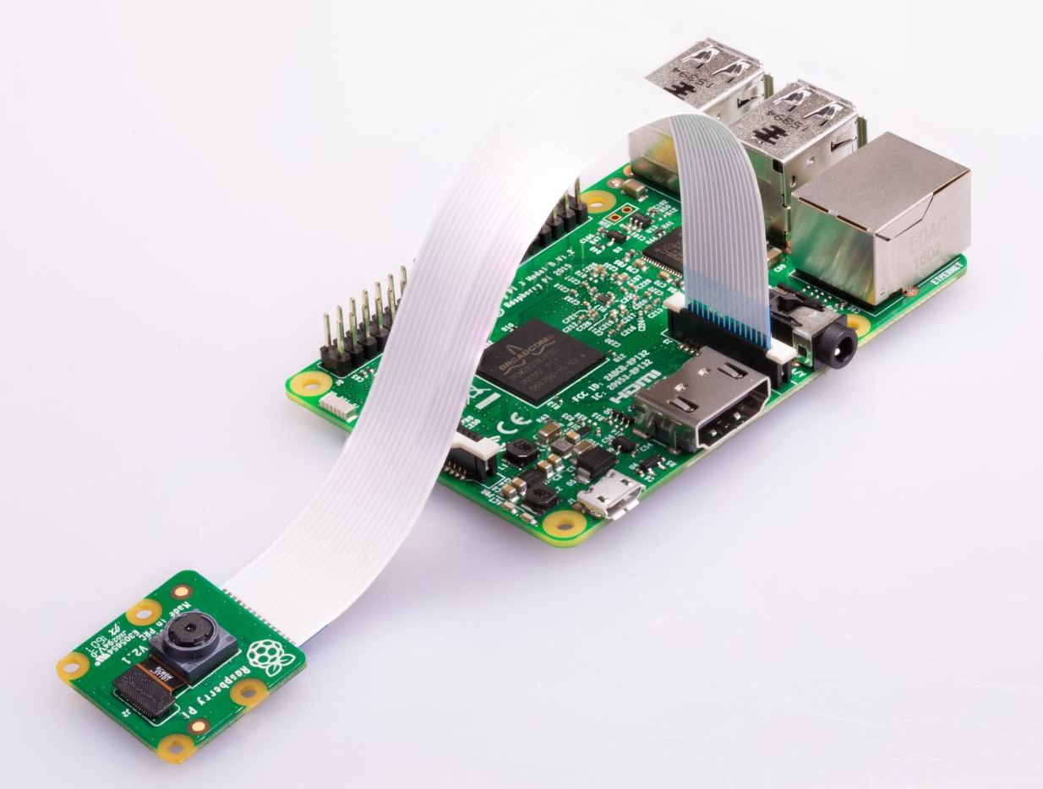
Pi Camera
Plug in camera and make sure it is enabled in settings
On command line, use “Raspistill” to save images
From python, use picamera module with capture(filename) function to save image
Cost approx £6
Pi Noir camera lacks an
infrared filter, so better
for low light image capture

Slide 19
Taking Photos and Videos
Raspistill command to save images
raspistill -vf -hf -o test.jpg
Run raspistill on multi-capture mode
raspistill -vf -hf -w 640 -h 480 -o image%03d.jpg -tl 1000 -t 30000
Combine stills into time lapse video
avconv -i image%03d.jpg -r 6 timelapse.avi
Or, take real time video
raspivid -o vid.h264

Slide 20
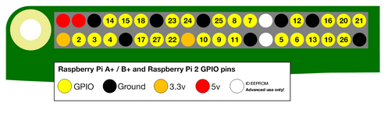
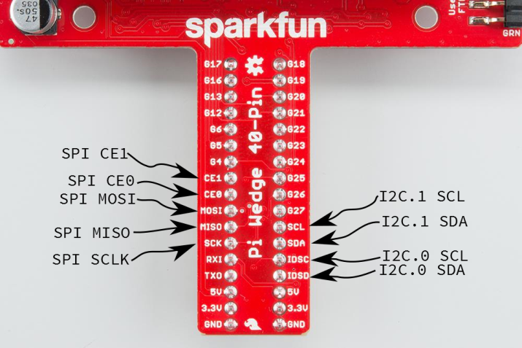
The GPIO Bus
GPIO = General Purpose Input/Output
Used to connect sensors and devices/peripherals

Slide 21
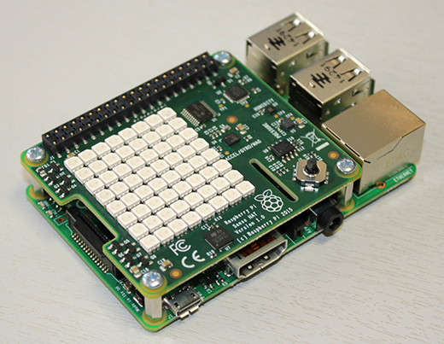
HATs (Hardware Attached on Top)
HATs are add-on circuit boards that provide extra functionality to your Pi and plug into GPIO bus
Sense HAT
8 x 8 multicolour LED matrix
Motion sensors (accelerometer,
gyroscope, compass)
Temperature sensor
Pressure sensor
Humidity Sensor
Mini joystick

Slide 22
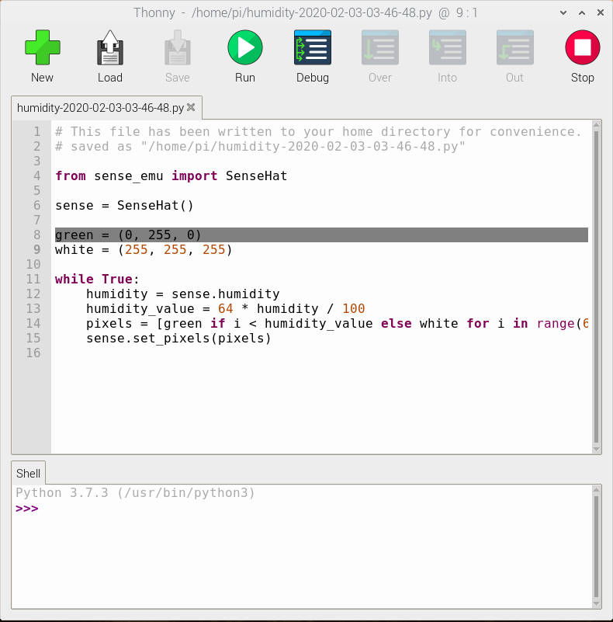
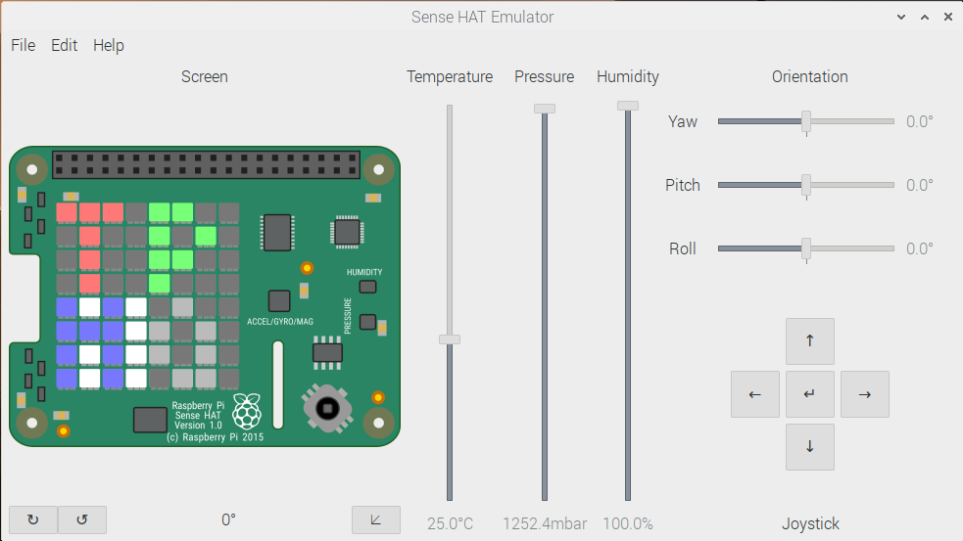
Programming the Sense HAT
Use python to program the sense hat or sense hat emulator
from sense_hat import SenseHat #Hat
from sense_emu import SenseHat #Emulator
Emulator screenshot:

Slide 23
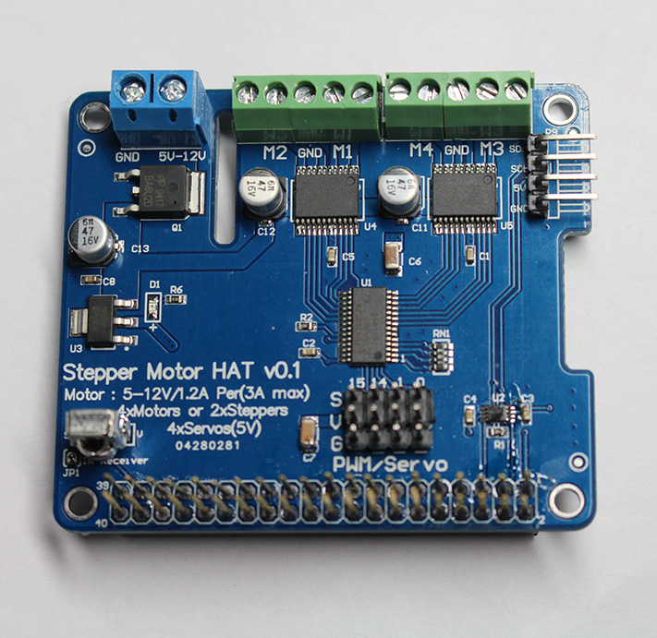
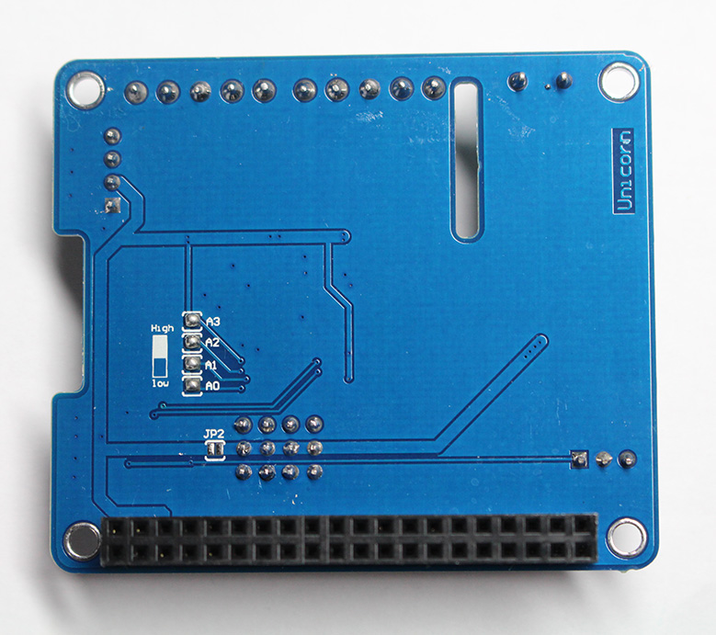
Motor HAT
Easily control DC or Stepper motors (e.g. build robots)

Slide 24
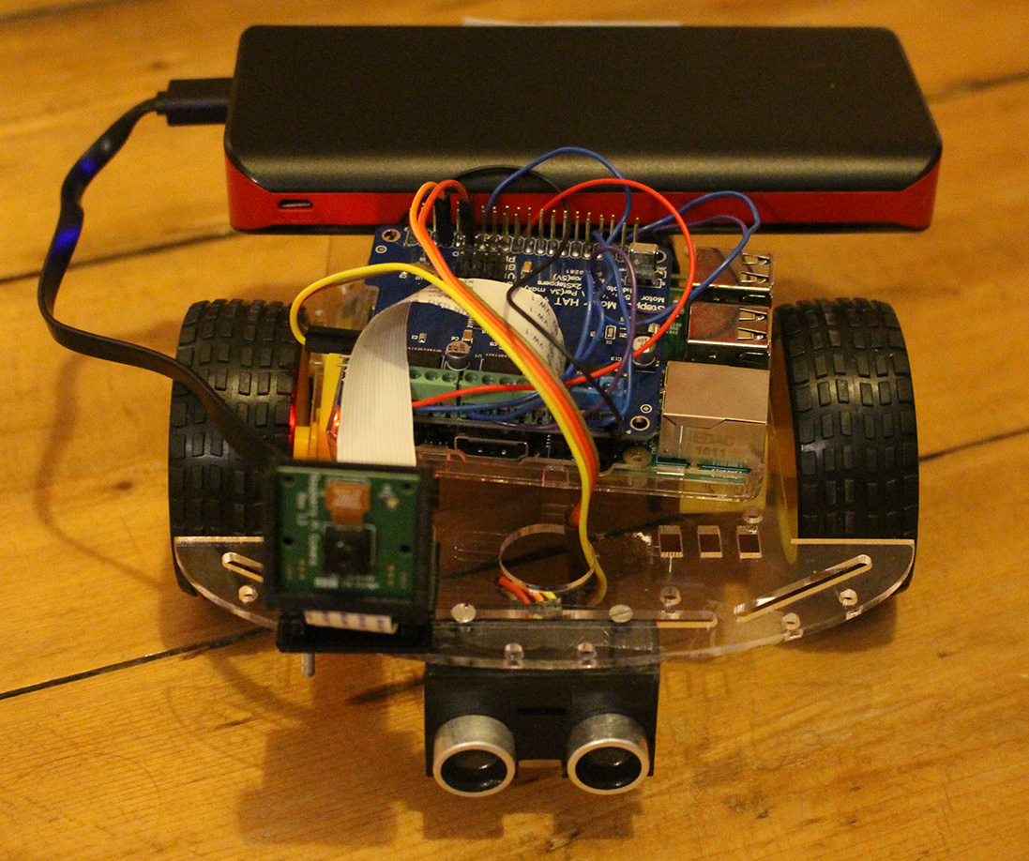
Robot with Motor HAT

Slide 25
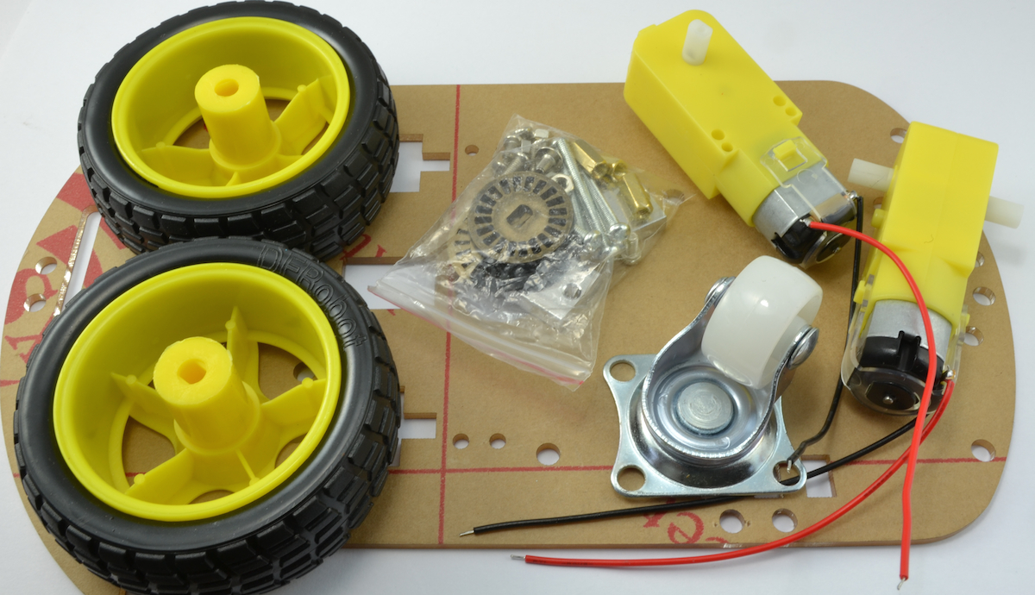
Motors, wheels and chassis
Kit from e-bay – cost approx. £7

Slide 26
Controlling the motors
Adafruit motor hat library for Python:
sudo pip install Adafruit_MotorHAT
setSpeed(n) where n is 0 to 255
run(Adafruit_MotorHAT.FORWARD)
run(Adafruit_MotorHAT.BACKWARD)
run(Adafruit_MotorHAT.RELEASE)
Curses library for terminal handling:
getch() - detects a key press to control the robot

Slide 27
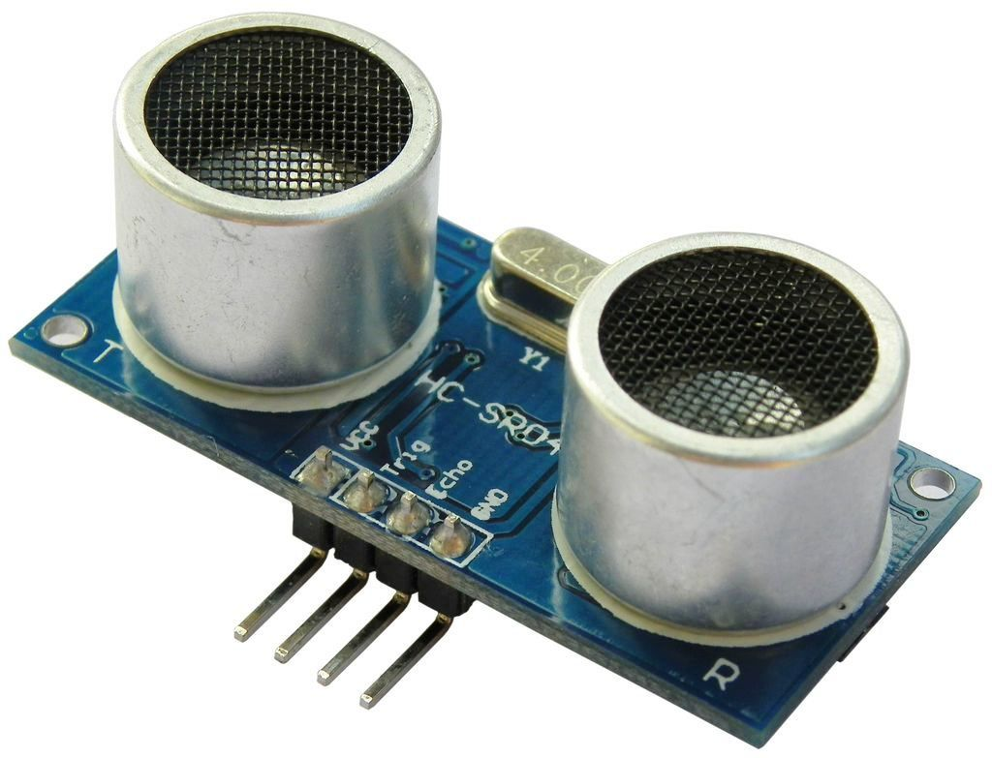
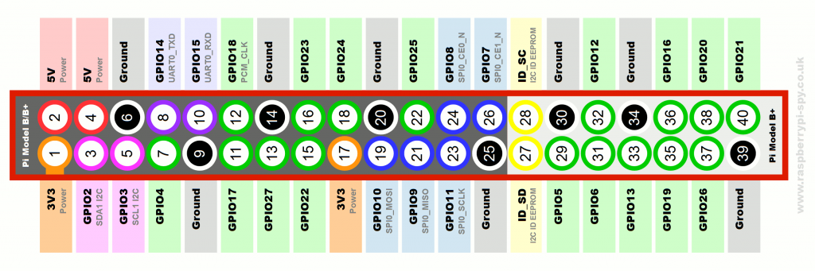
Ultrasonic Sensor (HC-SR04)
Cost approx £1 on ebay
Approx 15 degree beam width
Connections:
VCC (5V) => GPIO pin 2
TRIG (GPIO4) => GPIO pin 7
ECHO (GPIO17) => GPIO pin 11
GND (0V) => GPIO pin 6

Slide 28
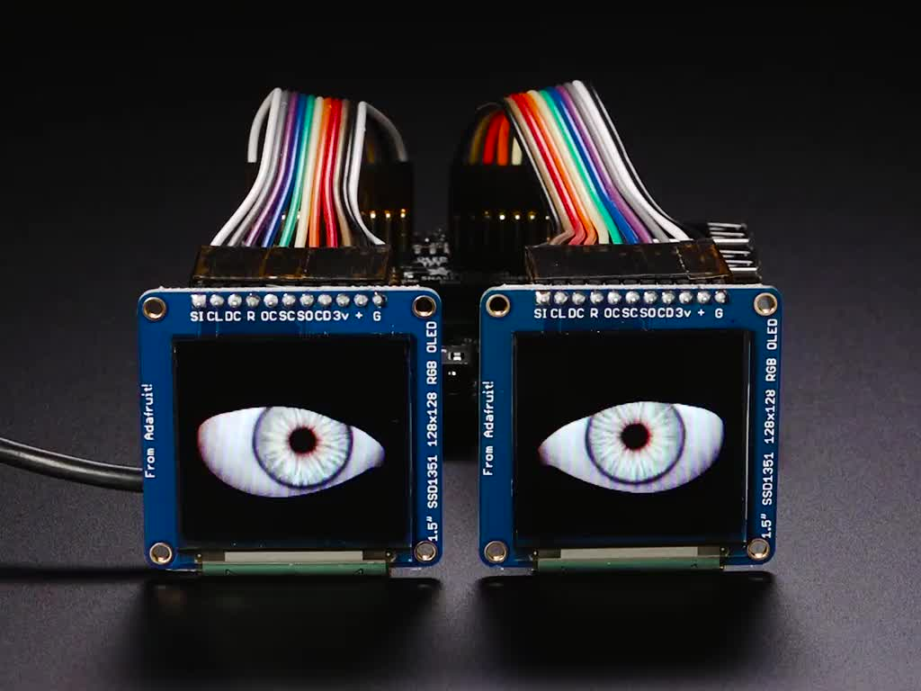
Other HATs
PWM/Servo Motor HAT
Perma-Proto HAT (for prototyping circuits)
GPS HAT
Picade HAT – turn Pi into an arcade machine, e.g. to emulate old games console
Piano HAT – adds a 13-key piano keyboard and synthesizer control
OLED Bonnet (adds compact OLED display with 128 x 64 pixels)
Adafruit Animated Eyes Bonnet – add two displays and use for masks, costumes and props
See https://www.adafruit.com/category/286 for many others

Slide 29

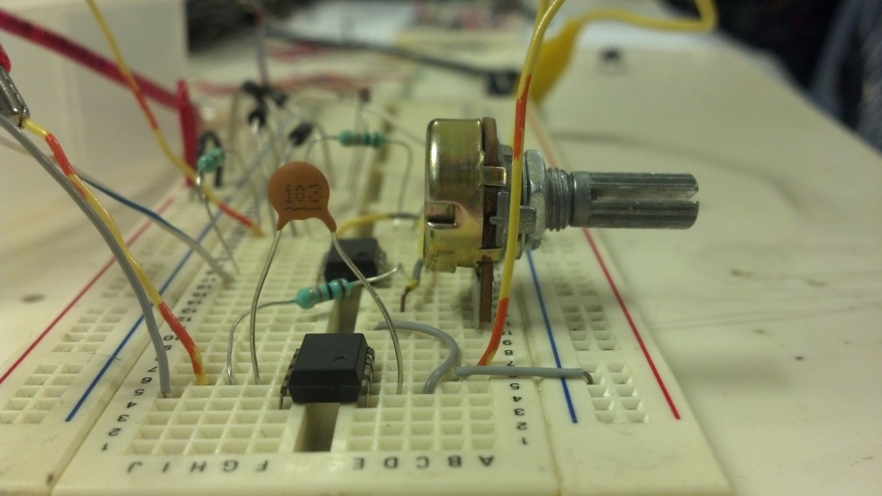
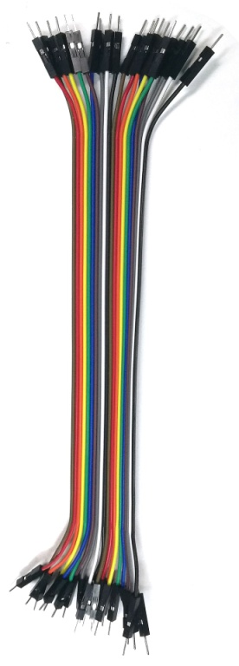
Custom Electronic Circuits
Beginners kits available
Use “breadboard” to avoid soldering

Slide 30
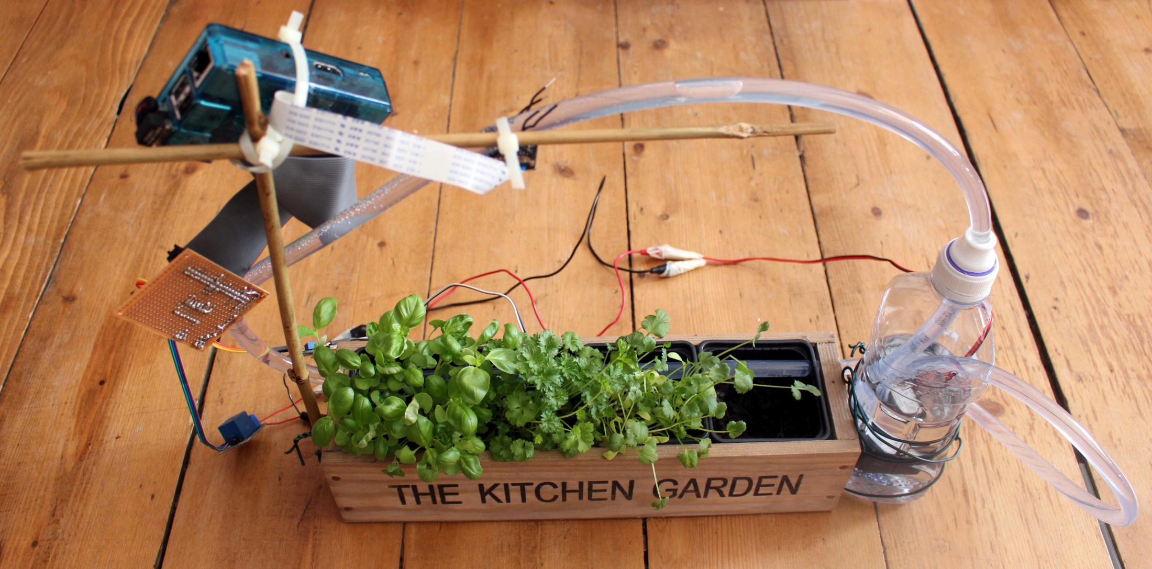
Automatic Plant Watering

Slide 31
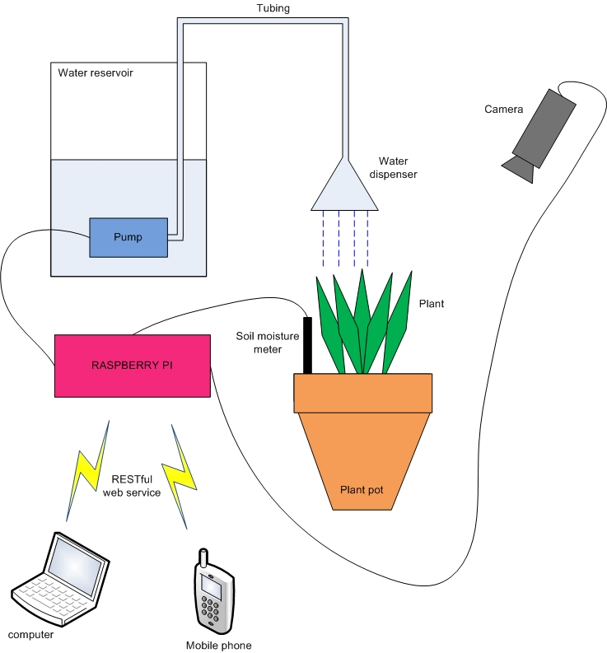

Slide 32
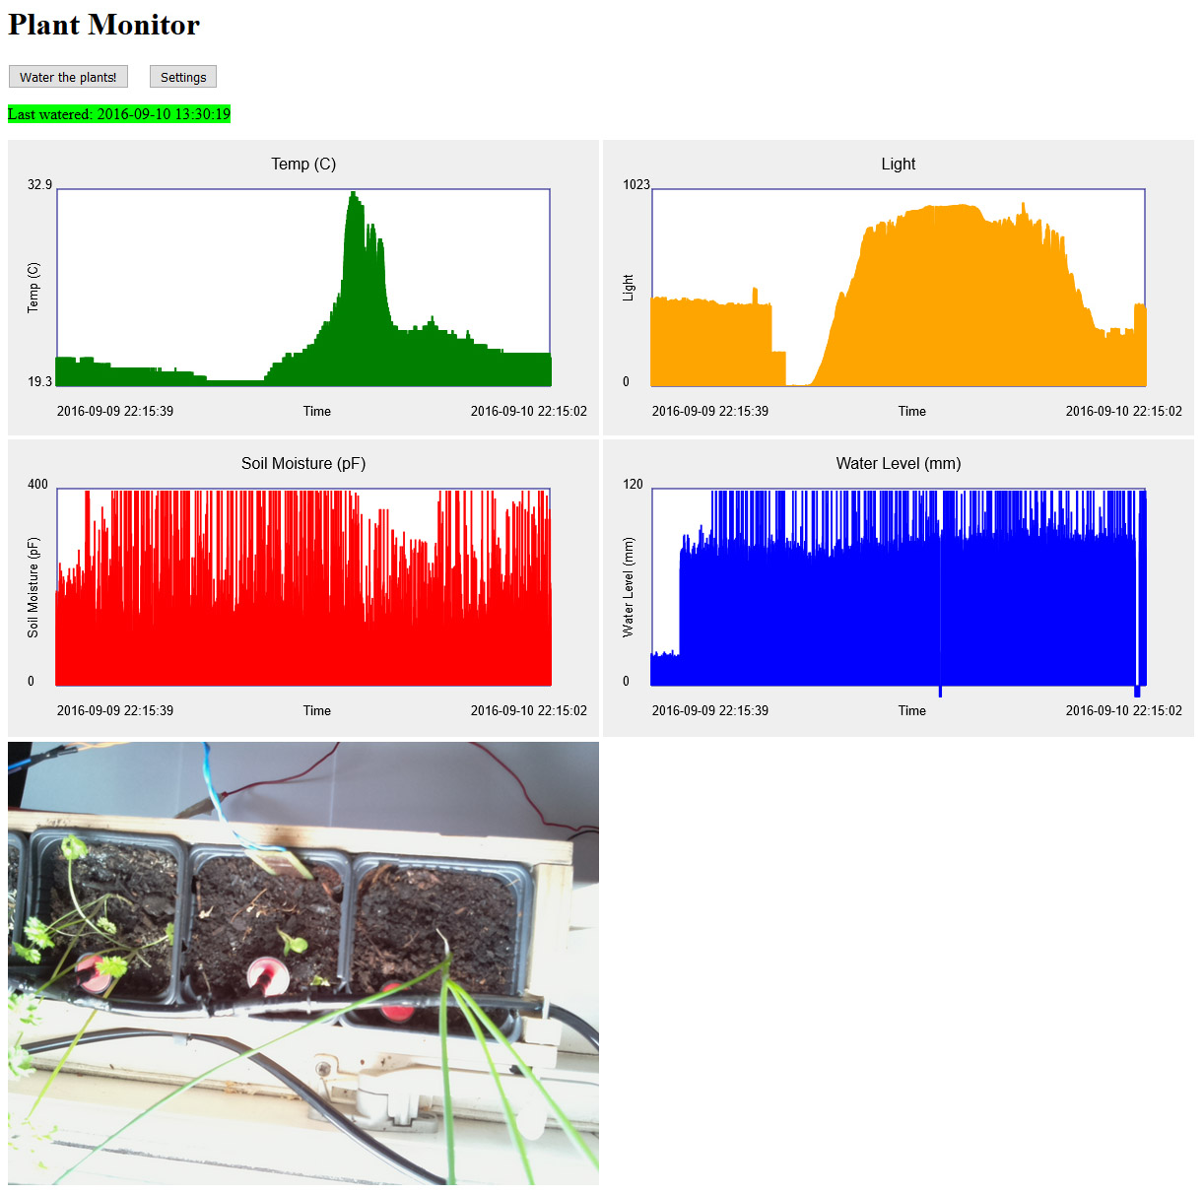

Slide 33

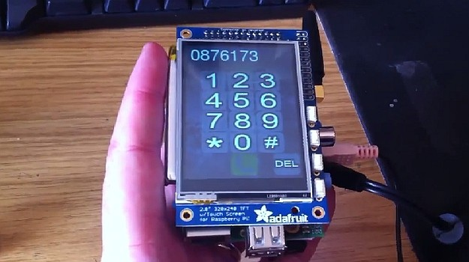
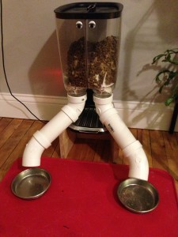
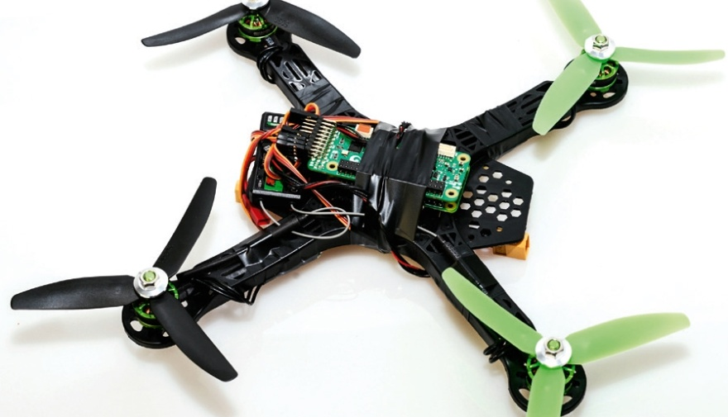

Other projects on internet
3D Body Scanner
PiPhone smartphone
Pet feeder
Drone
BeetBox – turns vegetables into drums

Slide 34
Follow-up
I’ll make the slides available - check meetup group, or message me.
Lots of open source Raspberry Pi projects shared on the internet
Now there is the possibility to combine with Cloud service, e.g. AWS IOT
Any projects that anyone wants to build?
If you have a project idea, ask me if you’re looking for help/advice on electronics, soldering, circuit board etching, 3D printing, etc.
Any questions??
Contact details: Email – alisonaird@me.com or message me via meetup.com or twitter (@amaird)

